Slide 1
Commerce Transaction Platform (Monolith to Azure Migration)
Presented by Rajib Mishra
./run.sh "Pre-work Material Orders_Source_A.csv" "Pre-work Material Orders_Source_B.csv"

Slide 2
Clarifying questions – Risk Reduction
The solution demonstrates how heterogeneous partner inputs can be normalized into a stable canonical event model, enabling Fortegra to scale onboarding while retaining governance, auditability, and decision authority.
Source & Data Semantics
Are SKUs unique per partner, per program, or globally?
Can a single order contain mixed product semantics?
How should retired or renamed SKUs be handled?
Volume & Latency
Expected peak order and item throughput per source?
Batch vs near-real-time expectations?
Replay windows and retention requirements?
Governance & Compliance
Regulatory retention and audit requirements?
Source-level SLAs and data quality expectations?
How are disputes and corrections handled?
Platform Evolution
Expected cadence of new partner onboarding?
Schema evolution tolerance (backward/forward compatibility)?
AI advisory vs decision authority boundaries?
Notes:
Fortegra’s challenge isn’t data ingestion — it’s absorbing partner variability while preserving underwriting authority, financial accuracy, and auditability as programs scale.

Slide 3
Clarifying questions – Risk Reduction-Scenarios
SKU Semantics Ambiguity: Let’s say stakeholders tell you SKUs are only unique within a partner, not across programs. What changes?
That confirms SKU cannot be a global identifier. I would treat SKU as a partner-scoped business attribute and rely on contextual identity — partner, program, order — for uniqueness. The canonical model remains unchanged; the adapter enforces partner scoping and mapping.
Throughput & Burst Volume: What if a large partner sends us millions of items in a short window?
That validates the event-first approach. Event Hub partitions on order or partner allow horizontal scaling, and consumer groups isolate billing and fulfillment load. Replay and backpressure are handled without impacting ingestion.
Replay & Correction Needs: Stakeholders say they often need to reprocess historical data after rule changes. How do you handle that?
Because events are immutable and retained, we can replay from a known offset into a new consumer group or versioned service. We don’t mutate history — we re-derive outcomes deterministically.
Schema Evolution Uncertainty: What if partners can’t commit to stable schemas?
That pushes responsibility into the adapter layer. I’d enforce schema versioning and validation there, defaulting unknown fields to extensions. Canonical contracts evolve deliberately, not reactively.
SLA & Accountability: How do we know which partner is causing issues?
Source identity is preserved end-to-end. Observability is partitioned by partner, enabling per-source SLAs, error budgets, and throttling without affecting others.
Notes:
Fortegra’s challenge isn’t data ingestion — it’s absorbing partner variability while preserving underwriting authority, financial accuracy, and auditability as programs scale.

Slide 4
Clarifying questions – Risk Reduction-Scenarios-Continued…
Business Ownership Boundaries: Stakeholders want vendors like InsureMO to ‘just handle it.’ Why not?
Vendors accelerate configuration and orchestration, but Fortegra must retain decision authority. Otherwise, we externalize risk and lose consistency. The platform enforces this boundary by design.
AI Pressure: Stakeholders want AI to auto-approve decisions. Thoughts?
AI can advise, score, and surface anomalies, but decisions must remain deterministic and auditable. AI outputs become inputs to rules — not replacements for them.
Notes:
Fortegra’s challenge isn’t data ingestion — it’s absorbing partner variability while preserving underwriting authority, financial accuracy, and auditability as programs scale.

Slide 5
The Business of Platforms – Practical/Proven Considerations (B2B limited B2C)
Core Idea
Platforms create value by enabling interactions between producers and consumers, not by owning end products.
Key Principles
Ecosystem over pipeline: Success comes from orchestrating participants, not controlling every step.
Core vs. complements: The platform owns the stable core; partners innovate at the edges.
Governance > control: Rules, standards, and incentives matter more than direct ownership.
Network effects: Value grows as more participants join and interact.
Modularity & openness: APIs, events, and clear contracts enable scale without chaos.
Why It Matters
Winning platforms balance openness (to grow) with control (to govern).
Platforms that over-own stagnate; platforms that under-govern fragment.
Fortegra Alignment (Implicit)
Fortegra as the decision & governance platform
MVAs/partners as producers
APIs + events as interaction mechanisms
Canonical models as platform rules
Notes:
Fortegra’s challenge isn’t data ingestion — it’s absorbing partner variability while preserving underwriting authority, financial accuracy, and auditability as programs scale.

Slide 6
Platform Design Goals & Operating Principles
Guiding principles used to solve the assignment under time constraints
Clear ownership boundaries
Fortegra domain services own decisions and financial truth
InsureMO orchestrates
Unqork enables human workflows
2. Event-first decoupling
Canonical events are the source of truth
APIs are for commands, not outcomes
3. Hybrid resilience by design
Billing runs in Azure
Fulfillment remains on-prem
Event Hub insulates cloud from on-prem risk
4. Operability as a first-class concern
End-to-end observability across adapters, Event Hub, APIM, domain services, and fulfillment
Design decisions prioritize decoupling, auditability, and long-term platform flexibility over tool-centric integration.
Notes:
Fortegra’s challenge isn’t data ingestion — it’s absorbing partner variability while preserving underwriting authority, financial accuracy, and auditability as programs scale.

Slide 7
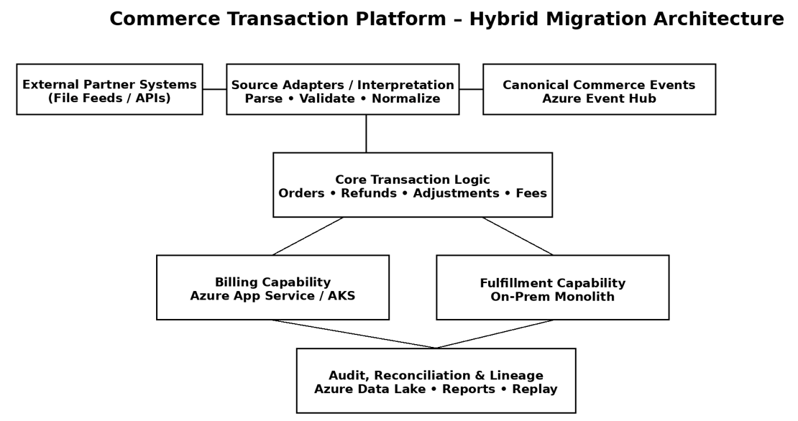
Reference Architecture-Key Components
1
2
3
4
5
6
7
Canonical event-driven platform enabling independent onboarding, replay, and governance.
Notes:
All partner-specific complexity is absorbed at the edge. Internally, everything operates on canonical events. Event Hub gives us replay, audit, and decoupling. Decisions flow back to MVAs as authoritative outcomes.

Slide 8
PaaS-First Platform with Selective SaaS Experiences
command vs event split
Fortegra as the authoritative decision & governance platform
MVAs integrate via command APIs and canonical events
Canonical event model isolates partner and workflow variability
Vendors accelerate orchestration and experience — not business authority
Notes:
Rather than a single SaaS, this is a PaaS-first strategy. Fortegra owns decisions and governance. InsureMO orchestrates insurance workflows. Unqork delivers experience where humans are involved.

Slide 9





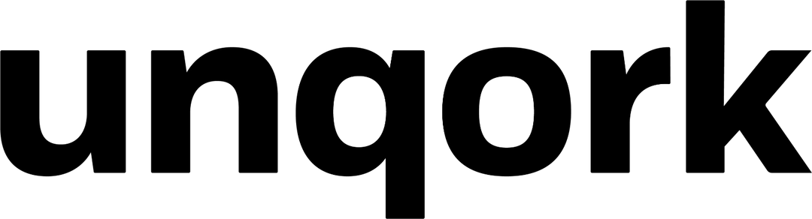
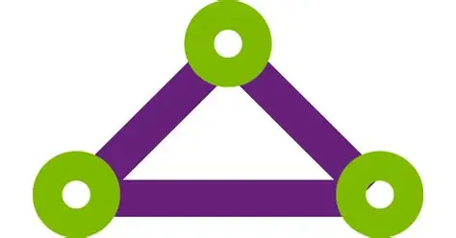



Composable, Event-Driven Reference Architecture
1
order_id,
policy_id,
program_id
submission_id
cg-billing
MVA #1
MVA #2
MVA #3
Decisions Event (12-nomalized key fields)
4
cg-fulfillment
10-fields
13-fields
2
3
cg-insureMO
ItemFulfilled
ItemShipped
FulfillmentCompleted
FulfillmentFailed
DeliveryConfirmed
Adapter Layer
Canonical Events (2.2)
Item-Level Normalization
cg-ops-audit
Parsing | Validation | Linting
Replay | Partitioning | Audit
Schema validation (2.1)
P95 / P99 Latency
Auth / Throttle ErrorsRequests per Consumer
Billing
Ingestion Success %
Schema Validation Fail Rate
Time-to-Onboard (days)
Validation Error Rate
Lint Warnings / Partner
Quarantine Volume
4
5
Approve
Underwriting
Stateful/No Replay
Azure APIM
7
7
Fortegra Staff
Consumer Lag (by group)
Throughput (events/sec)DLQ / Poison Events
Billing
On-Prem Gateway
ER/S2S, Azure Ark
7
Fortegra Domain Services/Decisions + Insurance MO
Decision Success Rate
Time-to-Decision (SLO)Business Exceptions
Policy | Billing | Premium | Compliance | Underwriting | Pricing | Finance
Fulfillment (On-Prem)
Local Outbox/Retry/Replay
Platform Observability
6
Workflow Completion Time, Orchestration Failures, Retry Rate
7
Notes:
All partner variability is absorbed at the adapter layer. Once data becomes canonical, everything inside Fortegra operates consistently. Event Hub gives us replay and audit, and decisions flow back to MVAs as authoritative outcomes.
InsureMO owns:
Policy lifecycle orchestration
Program configuration
Workflow coordination
Integration choreography

Slide 10
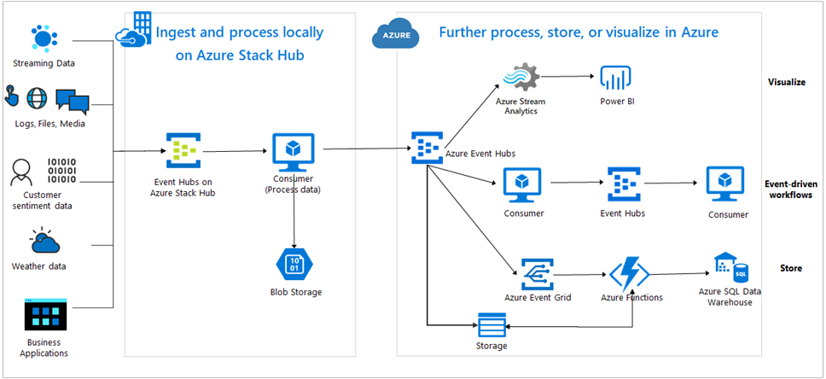
Network connectivity (how bytes move)
Notes:
Rather than a single SaaS, this is a PaaS-first strategy. Fortegra owns decisions and governance. InsureMO orchestrates insurance workflows. Unqork delivers experience where humans are involved.

Slide 11
Appendix
Notes:
Rather than a single SaaS, this is a PaaS-first strategy. Fortegra owns decisions and governance. InsureMO orchestrates insurance workflows. Unqork delivers experience where humans are involved.

Slide 12
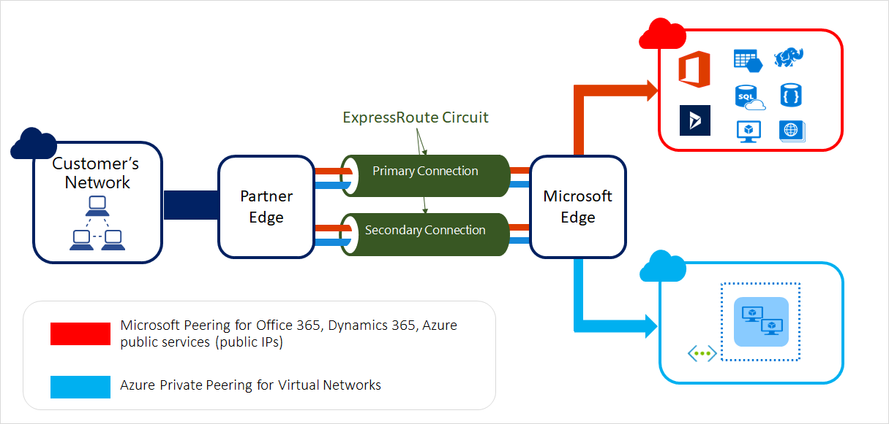
Network connectivity (how bytes move)
Notes:
Rather than a single SaaS, this is a PaaS-first strategy. Fortegra owns decisions and governance. InsureMO orchestrates insurance workflows. Unqork delivers experience where humans are involved.

Slide 13

Network connectivity (how bytes move)
Notes:
Rather than a single SaaS, this is a PaaS-first strategy. Fortegra owns decisions and governance. InsureMO orchestrates insurance workflows. Unqork delivers experience where humans are involved.

Slide 14
AI / Generative AI Opportunities for Fortegra Platform
AI-assisted adapter generation & schema drift detection – accelerate onboarding of MVAs/partners by generating parsers, mappings, and tests while detecting contract deviations early.
Event quality scoring & anomaly detection – apply ML to canonical events to identify data issues before impacting billing, fulfillment, or compliance.
Underwriting & pricing decision support (advisory only) – augment Fortegra-owned rules with risk and pattern insights without transferring decision authority to AI.
Operational intelligence & predictive observability – forecast Event Hub lag, consumer backlogs, and SLA risk; auto-summarize incidents to reduce MTTR.
Human-in-the-loop workflow assistance – use GenAI to summarize cases, exceptions, and rationale within Unqork workflows for faster reviews.
Governed AI usage model – AI consumes events and produces recommendations; domain services remain deterministic, auditable, and authoritative.
Notes:
Rather than a single SaaS, this is a PaaS-first strategy. Fortegra owns decisions and governance. InsureMO orchestrates insurance workflows. Unqork delivers experience where humans are involved.

